Slide 1
Ablation: Learning to Predict Layout-to-image Conditional Convolutions for Semantic Image Synthesis
Member: Syue-Cian, Lin Chong-Zhi, Xie Chen-Yuan, Yu

Slide 2
Outline
Problem Description
Technical Approach
Generator
Discriminator
Results

Slide 3
1. Problem Description

Slide 4
Video:
https://www.youtube.com/watch?v=p5U4NgVGAwg

Slide 5
2. Technical Approach - Generator

Slide 6
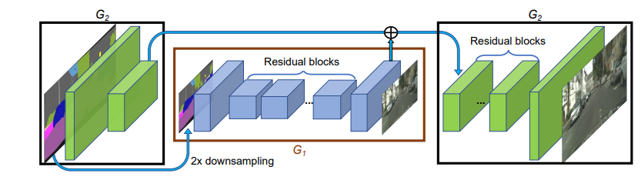
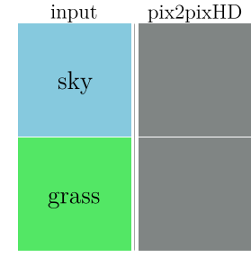
Pix2pixHD
Only use the label image and downsampling the image to get the features. Finally, decode the feature image to generate the synthesized image.
It will cause more time to generate image and cannot solve the single image label input.
SPADE
Pix2Pix

Slide 7
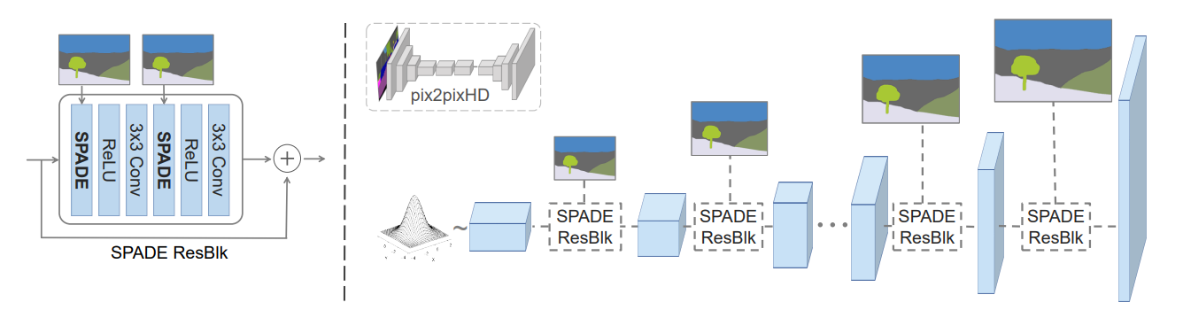
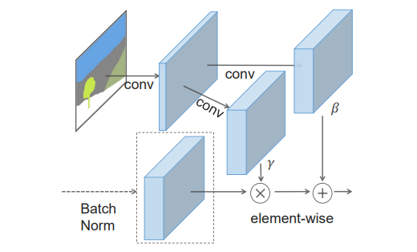
What is SPADE?
The label image is projected onto embedding space and convolved to produce the modulation parameters. It can get the feature from the single label input.
Fig.2. SPADE design

Slide 8
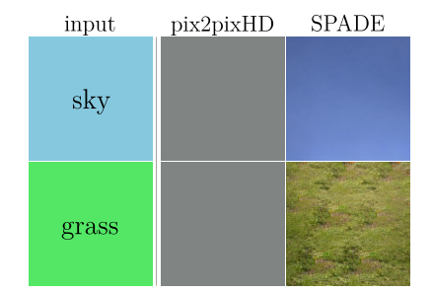
SPADE VS Pix2Pix

Slide 9
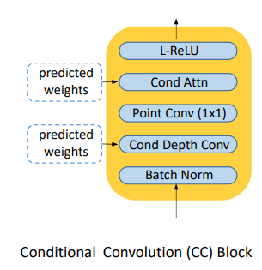
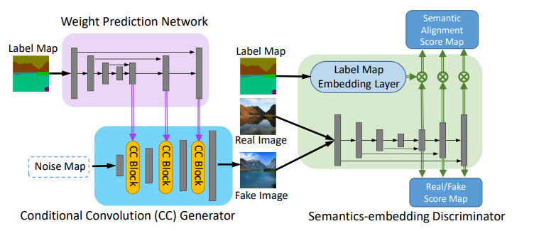
The more powerful method for semantic image synthesis
Conditional convolution – feature pyramid semantics embedding (CC-FPSE)
Use a feature pyramid to generate the predicted weights. What’s more, a feature pyramid can get global and local features. That is the reason why it has more details than SPADE
CC-FPSE

Slide 10
2. Technical Approach - Discriminator

Slide 11
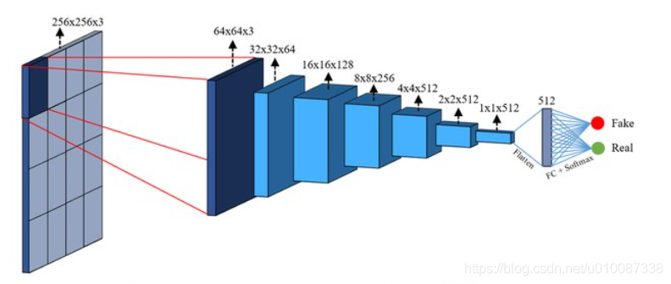
Discriminator: PatchGAN
Pix2Pix and SPADE use the PatchGAN to be the discriminator.
https://www.researchgate.net/figure/The-PatchGAN-structure-in-the-discriminator-architecture_fig5_339832261

Slide 12
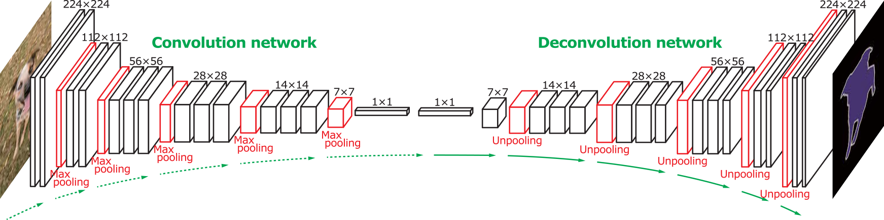
Discriminator: Feature pyramid
Taking inspiration from the shift from image pyramids, we propose a streamlined feature pyramid discriminator. Operating at a single scale, it combines bottom-up and top-down pathways to capture multi-scale information and ensure strong constraints on both semantic content and fine details.
https://iq.opengenus.org/downsampling-and-upsampling-in-cnn/

Slide 13
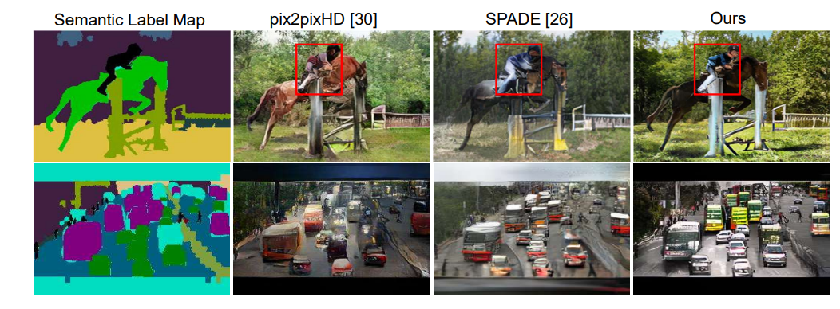
Compare results
CC-FPSE

Slide 14
3. Results

Slide 15
Setup
Our setup
GPU: NVIDIA 1060 6G
Training data: 200
Validation data: 200
Epoch: 200
Setup of paper
GPU: 16 * NVIDIA TITAN X
Training data: 118287
Validation data: 5000
Epoch: 200

Slide 16
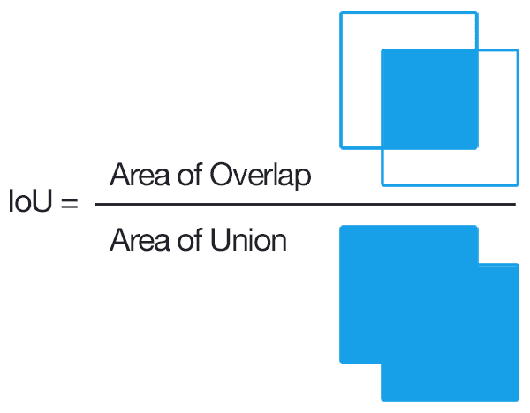
What is IOU?
https://pyimagesearch.com/2016/11/07/intersection-over-union-iou-for-object-detection/

Slide 17
Ablation from the CC-FPSE
The table shows that the different generators and discriminators have different results. Without a doubt, the CC-FPSE is the best method.

Slide 18
Performance results
Mean IoU (MIoU):
CC-FPSE | CC-FP | SPADE-FP | SPADE-FPSE
0.122 | 0.110 | 0.171 | 0.170

Slide 19
References:

Slide 20
Thank you for listening!

